Slide 1
UK Retail Analysis
Serena Du

Slide 2
Overview
UK Retail Company Data
Customer Segmentation: Target Customers
Sales Forecasting
Increase Sales!!!

Slide 3
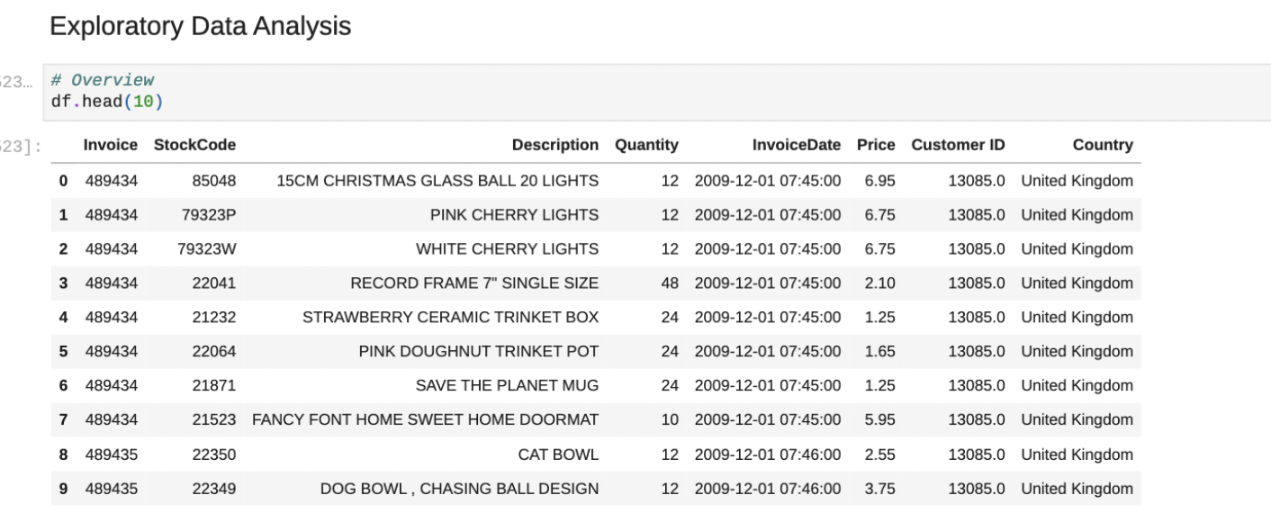
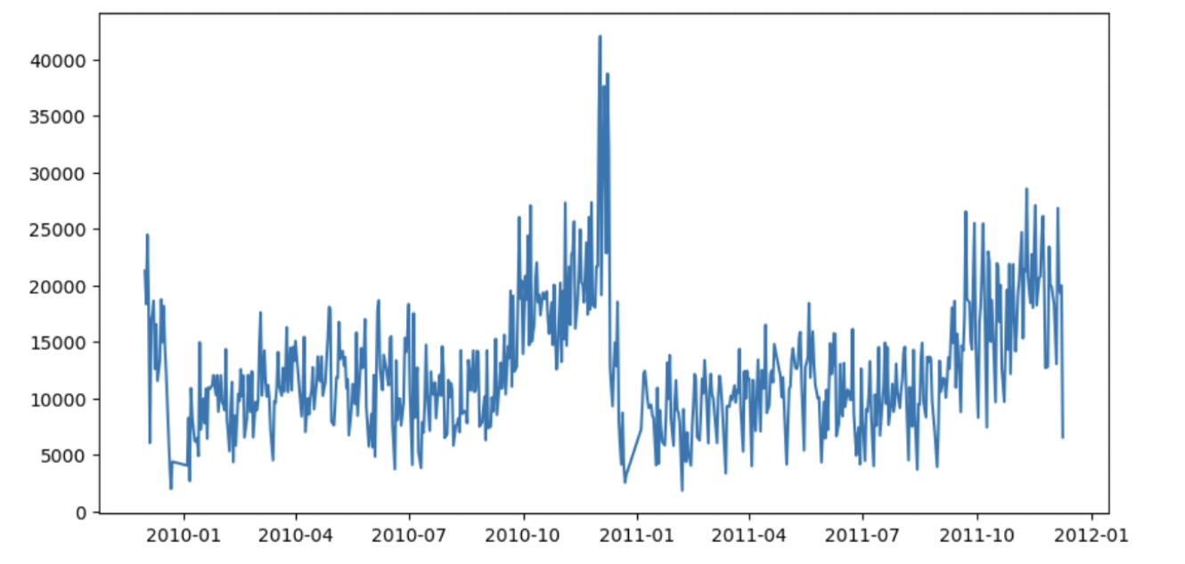
EDA

Slide 4
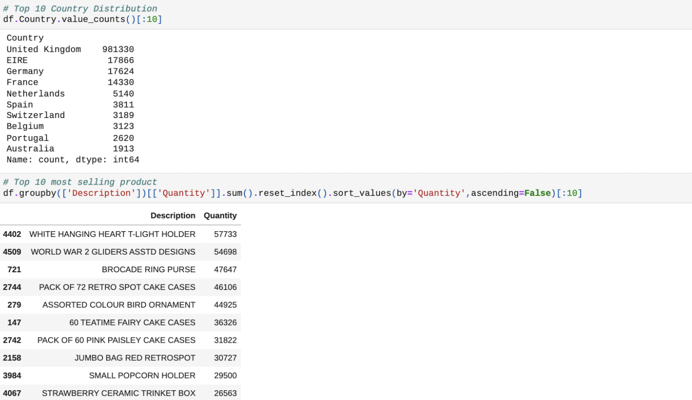
EDA

Slide 5
Data Quality
Add Sales Column (Price * Quantity)
Drop rows with missing values
Remove rows with Price as 0
Remove Rows that doesn’t represent a product
Remove outliers (10th-90th percentile)

Slide 6
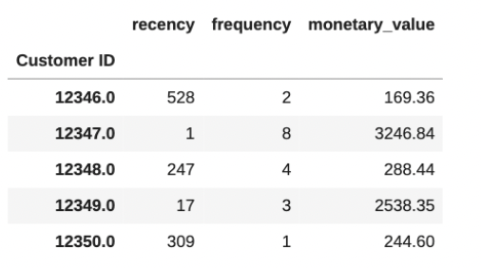
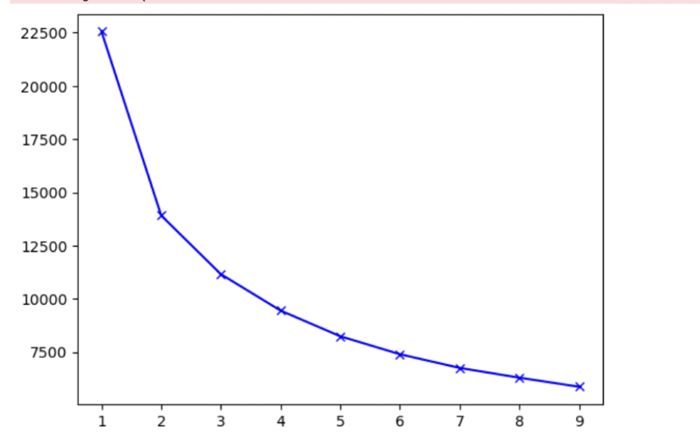
Customer Segmentation
RFM: Recency, Frequency, Monetary Value
K-means Clustering (K=4): good unsupervised model

Slide 7
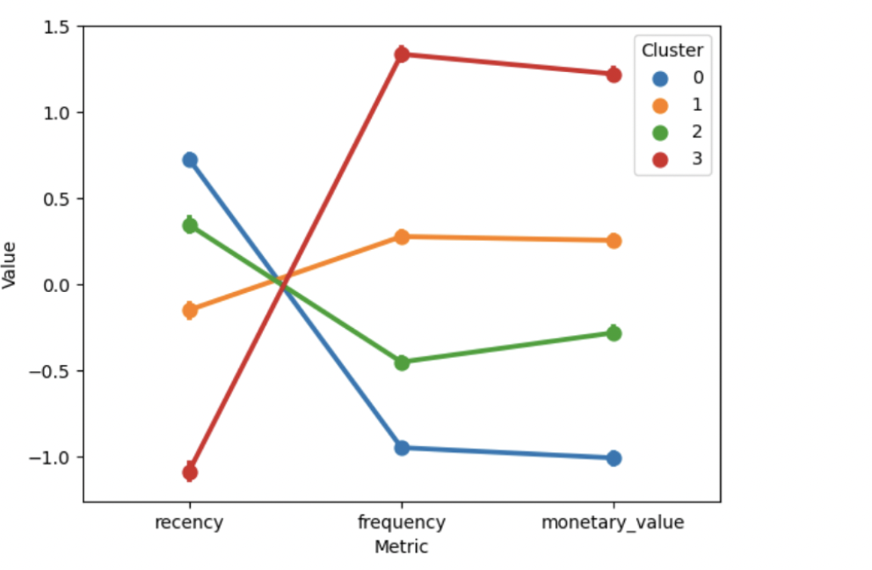
Customer Segmentation

Slide 8
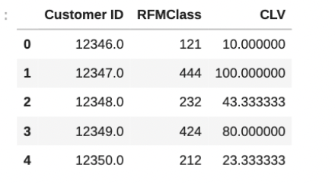
Customer Life value
Assign weights to RFM: 0.4 * recency + 0.3* frequency + 0.3* monetary_value

Slide 9
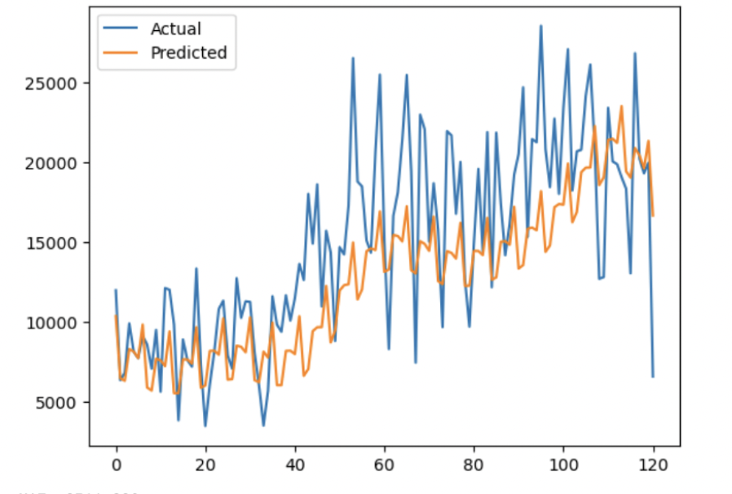
Forecasting
Segment forecasting with fbprophet model
Fbprophet is good with mean shift, seasonality and holiday trends
Measure error rate with MAE (100-400)
Forecast next quarter sales

Slide 10
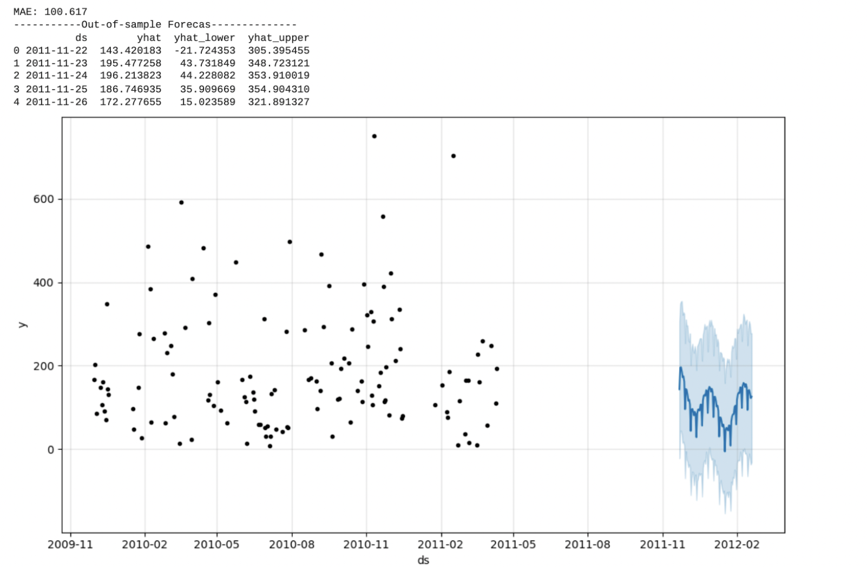
Segment 0 (New Customer)

Slide 11
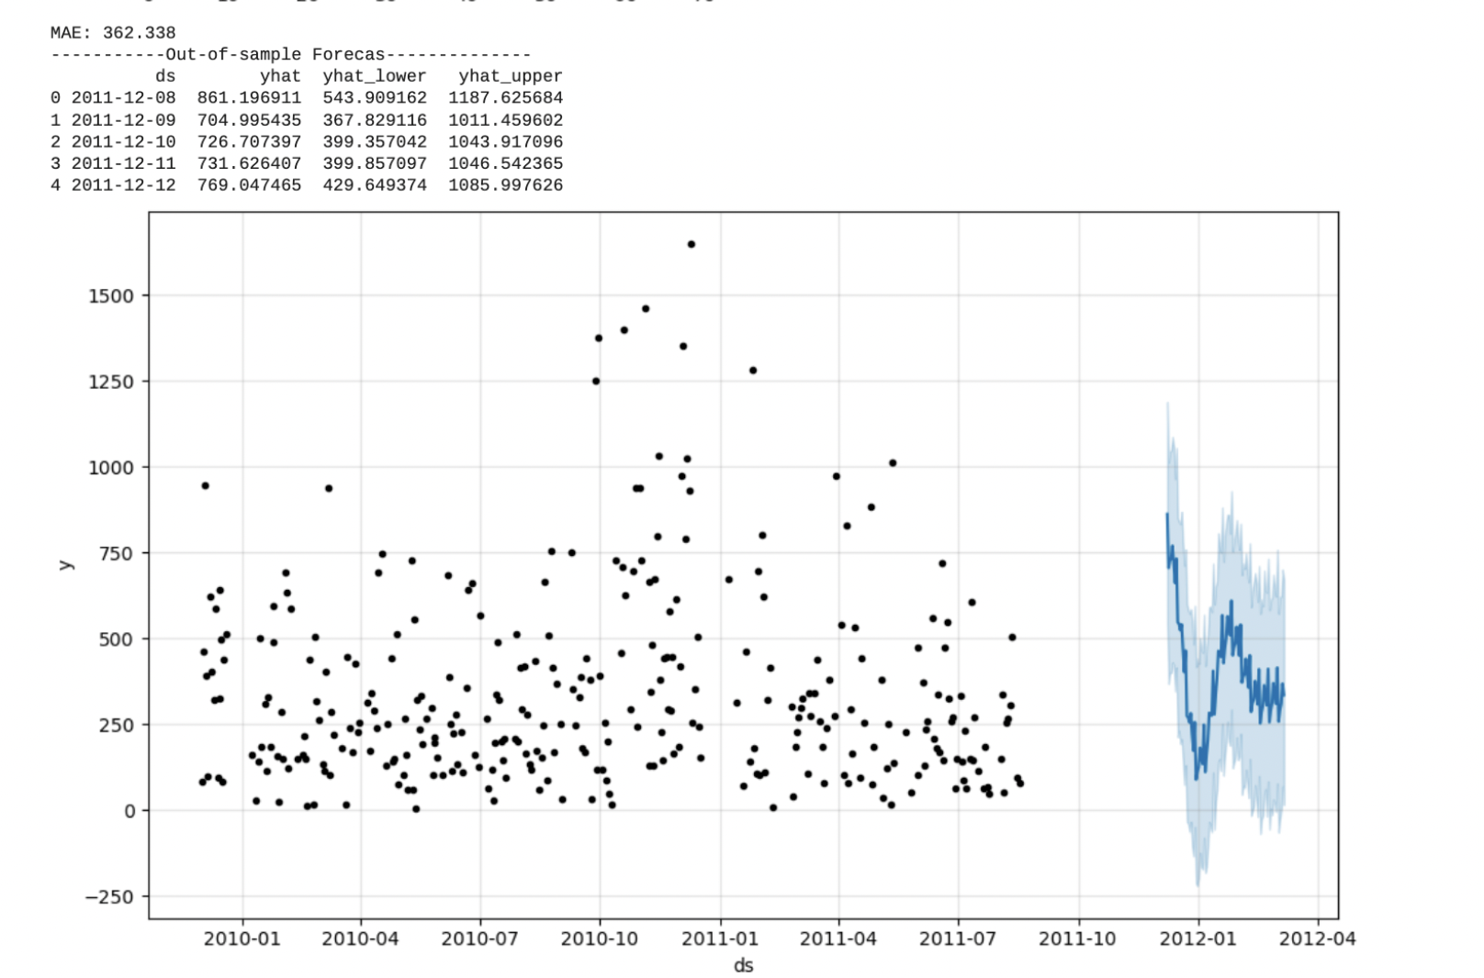
Segment 1 (Target Customer)

Slide 12
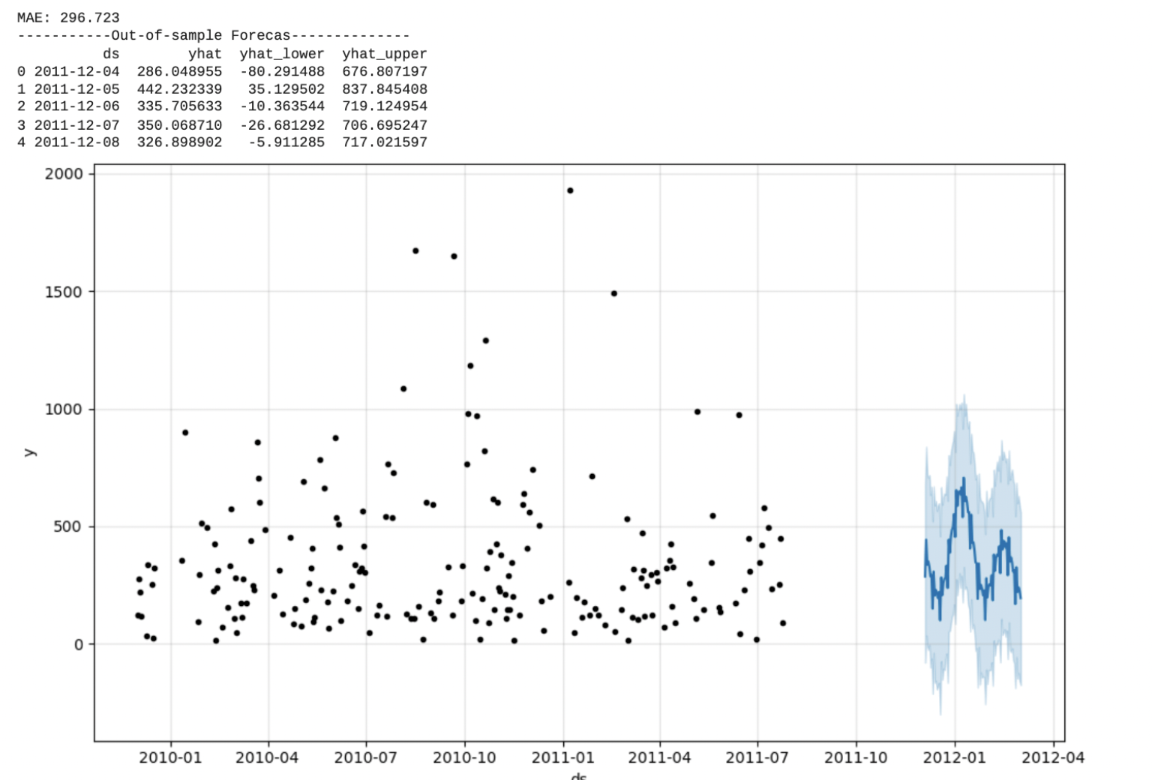
Segment 2 (Normal Customer)

Slide 13
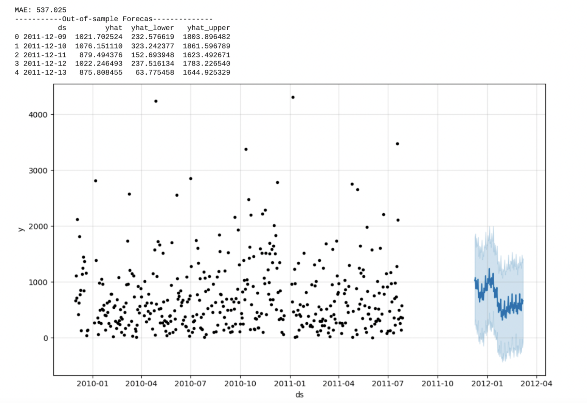
Segment 3 (Lost Customer)

Slide 14
Conclusion
Considered Return through RFM
Would like to do more analysis on return to minimize it

